Slide 5
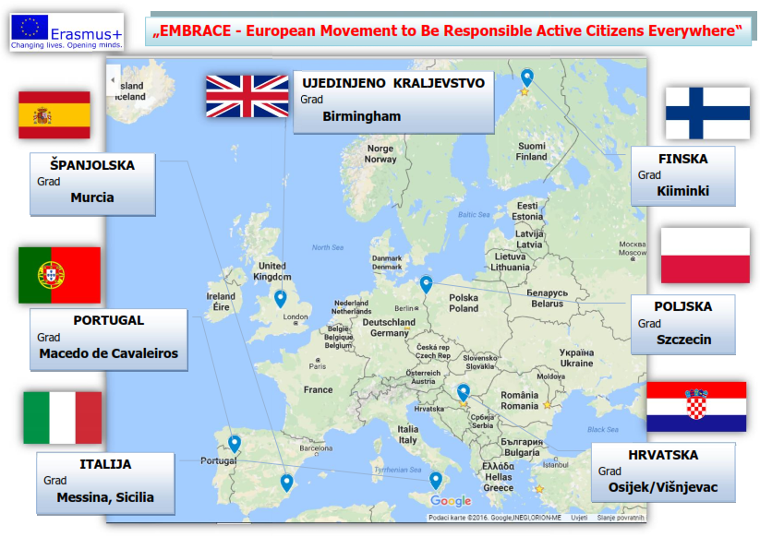

Slide 6
Mobility (journeys, travel)
United Kingdom (November 2016) (1679.82 km)
Poland (March, 2017) (925.23 km)
Italy (October, 2017) (858.24 km)
Spain (January, 2018) (1839.84 km)
Croatia (April, 2018)
Finland (October, 2018) (2219.80 km)
Portugal (March, 2019) (2105.72 km)

Slide 7
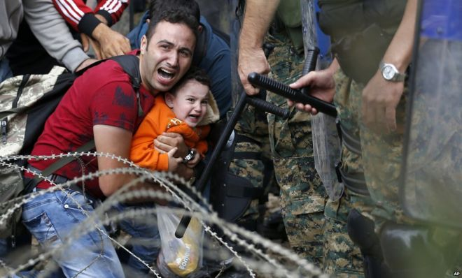
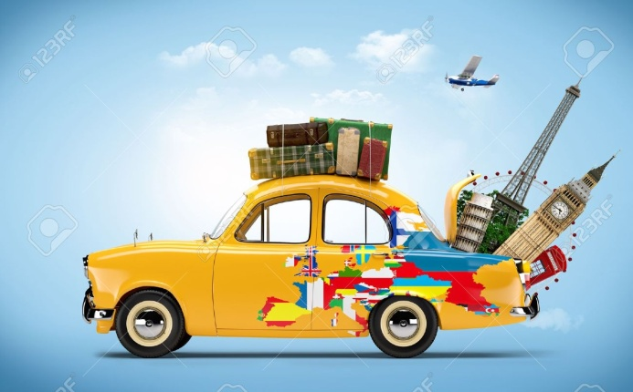
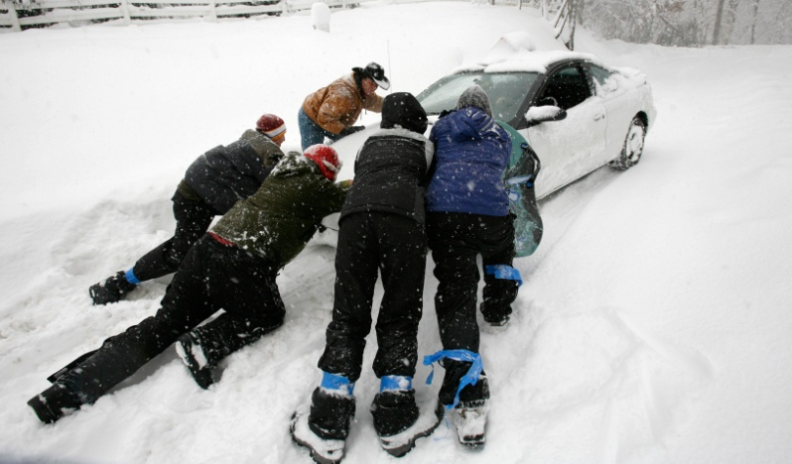
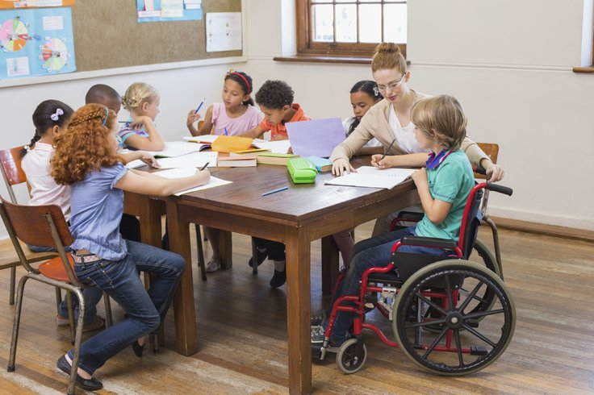
Activities

Slide 8
EMBRACE web site
web site
every partner will be responsible for its development and evaluation throughout the whole project
activity coordinator

Slide 9
EMBRACE logo competition
competition for project logo (artistic expression)
the best three from each partner country
online voting for the best
during the first three months of the project

Slide 10
European Junior Parliament
European Junior Parliament
the voice of the youth (pupils’ voice)
20 from each country
discussions, video conferences, blogs
throughout the project (2016-2019)
activity coordinator

Slide 11
EMBRACE Art for Humanity
expressing creativity– followed on e-Twinning
text reading, watching films with socially important topics (discrimination, race, gender, migration issues…)
creative pupils’ work: texts, videos, art work through different techniques, screenplays…
duration (2017/2018, 2018/2019)
activity coordinator

Slide 12
In their shoes
the goal is to understand stories of immigrants
follow the migration route on the map
write a migration diary, read some of them
creation of their countries and reasons of war
surveys on immigrants – survey analysis (each country and together in teams), making charts,
duration: 2016/2017
activity coordinator

Slide 13
The Human Rights Tree
making a human rights tree
origin – what is the most important to protect human rights
explain their trees
discussion
throughout 2016/2017
activity coordinator

Slide 14
Active Citizen newspaper articles
follow press and articles on human rights
posters 4 categories (Croatian and English) – respecting rights, disrespecting rights (violate), rights are protected, conflicts about rights
discussion in European Junior Parliament
fair play policy in sports
throughout 2018
activity coordinator

Slide 15
Patriotism vs Nationalism
survey among pupils
discussion on existing tensions in certain countries
map (list) of tensions on borders – suggestions for improvement
discussion in European Junior Parliament
joint song and recording of the song
throughout 2018/2019
activity coordinator

Slide 16
A short-story about a long journey
research on historical development of democracy
prepare a quiz
timeline of democracy (MyHistro web site)
throughout 2018/2019
activity coordinator

Slide 17
Being human
importance of appreciating people through selfless deeds
study examples of other people’s kindness
being creative when thinking of activities that can help starting something in order to help charity organisations
diary of good deeds
find examples in local/national newspapers
each school will put one or two small items in the package for donation to a local charity organisation
conversation with the members of the charity organisation to explain the effect of the donation
throughout 2017/2018 (from the first meeting)
activity coordinator

Slide 18
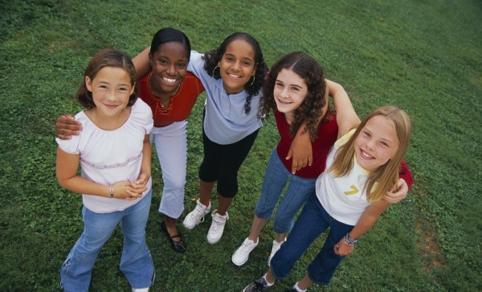
EMBRACE - ZAGRLJAJ

Slide 19
Journeys- mobility
plane tickets, bus tickets and other will be provided out of the project budget
pupils must have a passpor/ identity document
parents permission
travel insurance – out of the project budget
European Health Insurance Card – parents
Journey lasts - 3+2 days / 5+2 days
pupils are staying with hosting pupils

Slide 20
Pupils’ personality!
likes to travel, gain new knowledge and experience
open-minded, communicative
good command of the English language
flexible, tolerant
can host foreign pupils in their home
active in fulfiling the activities set by the project
listens to and accepts the leader of the journeys

