Slide 5
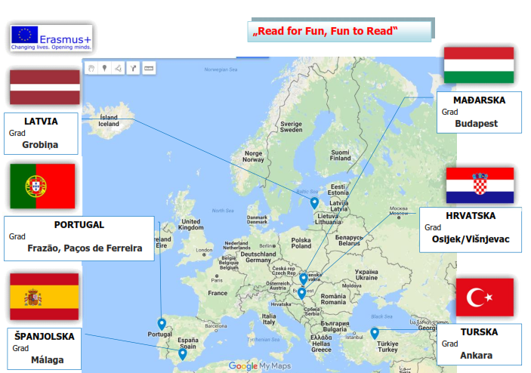

Slide 6
“Read for Fun, Fun to Read” 2016-1-PT01-KA201-022788
Latvia - Grobiņa
Portugal- Frazão, Paços de Ferreira - coordinator
Turkey – Ankara
Croatia – Osijek
Spain - Malaga
Hungary - Budapest
Project duration: 24 months

Slide 7
Mobility (journeys, travel)
Latvia – Grobiņa , October 2016 (1233.35 km)
Spain – Malaga, February 2017 (2159.81 km)
Hungary – Budapest, May 2017
Croatia – Osijek, November 2017
Portugal- Frazão, Paços de Ferreira – March 2018
Turkey – Ankara, June 2018 (1312.48 km)
(218.10 km)
(2228.87 km)

Slide 8
Project objective
professional development of teachers
presenting different cultures, getting to know and accepting others, discovering the greatness of diversity
reading is the key of learning and lasting success in life
improve the pupils’ reading habits
develop reading habits among our pupils and the pupils of the partner countries
6 topics and subtopics – the activities are conducted between each mobility activity and are presented to each other

Slide 9
First meeting, Latvia October 2016
draw a big map of Europe on the school as a start of the project
inform the pupils and teachers of the school about the project
a web site, facebook page and blog of the project will be created – following the pages, posting about the new events
mutual presenting of the partner countries in order to get to know each other
a detailed agreement about the activity timeline of the project, duties and other

Slide 10
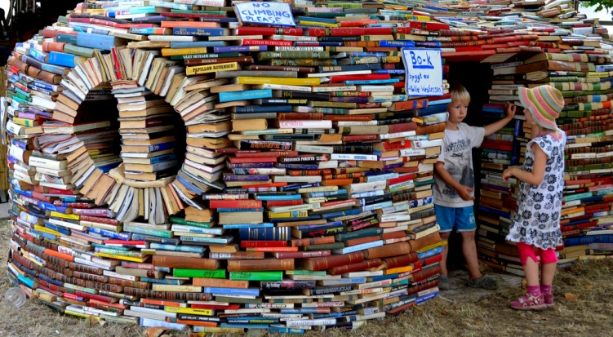
“Tale Heroes” – Spain February 2017
creating a time capsule with goals (wishes) for the project, which will be opened at the end of the project, its presentation
preparing of sweet boxes with tradiotional sweets which will be brought and exchanged between the partner countries
reasearch on national heroes in stories of other countries
come up with own hero stories (1 male, 1 female)
stories in Croatian (third grade)
stories in English (fourth grade)
illustrating the stories through various techniques (heroes) (second grade)
making posters, big flags, a project mascot (for photos), t-shirts etc.
present it all
local area visit
Teachers’ education- courses in
IT and communication and story writing

Slide 11
“Art” – Hungary, May 2017
pupils write stories on reading and act them out
preparing CDs with students’ role plays
preparing e-book with students’ stories
going to a children’s play
reading books to residents of a nursing home
preparing a book for visually impaired people (with stories)
local area visits
mutual presentation of CDs, e-books and exchange between the partner countries
visiting a concert in Hungary
five-day education of teachers on creative writing and digital design skills

Slide 12
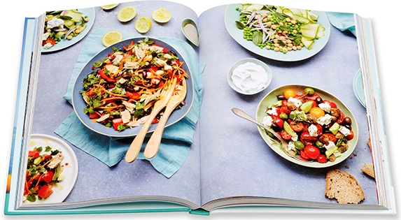
“Cook book” Croatia, November 2017
writing articles about the project
conducting a survey about the project among the pupils (survey created by Turkey)
research on traditional food of other countries with students
preparing a meal with students
visiting local area
“food festival” arrange special corners that represent the partner countries through their food, flags, tourist attractions etc.
images of food and promotion of culture day through slides and videos
discussion about the first project year, budget management

Slide 13
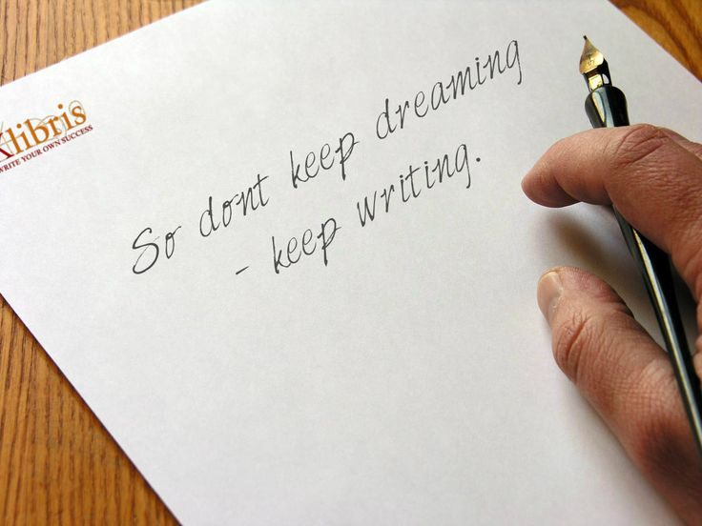
“Children’s book author and historical people” Portugal, March 2018
meet and greet with children’s book authors, talking to them, reading stories to each other, the authors and the children exchange books
shopping, playing games (scrabble, taboo, upwords), tournaments, awarding the winner with the goal to improve their language skills and vocabulary
research on famous historical people who liked to read, museum visit or a place with an exhibition of proverbs, pictures or personal items of these people (domestic and from the partner countries)
making a pinwall, posters with the topic:
online meetings with the partner countries
local area visit
review on what was done in previous 3 months
Teacher education on speaking and reading comprehension and motivation for reading

Slide 14
“Reading with Parents” Turkey, June 2018
choose the book titles that the parents will read
give maps of Europe
delivering books to families (after finishing each book, they can colour the country on the map of Europe that will be assigned for each book)
make an album with photos of mothers reading to their children
local area visit
making bookmarkers
present activities with parents (album with photos)
making big pinwall as a review of events throughout the whole project
general evaluation of project and conclusions
party within the project closing

Slide 15
Why participate?
mobility only for teachers
each mobility three teachers (coordinator + 2 teachers – 10 teachers)
paid trip, accomodation, travelling allowance
paid official substitute
three educations lasting 5 days
IT and communication and story writing course
creative writing and digital design skills
speaking and reading comprehension and motivation for reading
participating in project activities
travel insurance ensured out of project budget
get European Health Insurance Card
travel documents (ID, passport) valid 6 more months

